Slide 1
CAP 4770:
Introduction to Data Mining
Fall 2008
Dr. Tao Li
Florida International University

Slide 2
Self-Introduction
Ph.D. from University of Rochester, 2004
Research Interest
  Data Mining
  Machine Learning
  Information Retrieval
  Bioinformatics
Industry Experience:
  Summer internships at Xerox Research (summer 2001, 2002) and IBM Research (Summer 2003, 2004)

Slide 3
My Research Projects
You can find on http://www.cis.fiu.edu/~taoli

Slide 4
Student Self-Introduction
Name
  I will try to remember your names. But if you have a Long name, please let me know how should I call you ☺
Major and Academic status
Programming Skills
  Java, C/C++, VB, Matlab, Scripts etc.
Anything you want us to know
  e.g., I am a spurs fan. ☺

Slide 5
Acknowledgements
Some of the material used in this course is drawn from other sources:
Prof. Christopher W. Clifton at Purdue
Prof. Jiawei Han at UIUC
Profs. Pang-Ning Tan (Michigan State University), Michael Steinbach and Vipin Kumar (University of Minnesota)

Slide 6
Outline
Course Logistics
Data Mining Introduction
Four Key Characteristics
  Combination of Theory and Application
  Engineering Process
  Collection of Functionalities
  Interdisciplinary field
How do we categorize data mining systems?
History of Data Mining
Research Issues
  Curse of Dimensionality

Slide 7
Course Overview
Meeting time
  T/Th 11:00am – 12:15pm
Office hours:
  Tuesday 2:30pm – 4:30pm or by appointment
Course Webpage:
  http://www.cs.fiu.edu/~taoli/class/CAP4770-F08/index.html
  Lecture Notes and Assignments

Slide 8
Course Objectives
This is an introductory course for junior/senior computer science undergraduate students on the topic of Data Mining. Topics include data mining applications, data preparation, data reduction and various data mining techniques (such as association, clustering, classification, anomaly detection)

Slide 9
Assignments and Grading
Reading/Written Assignments
Research Projects
Midterm Exams
Final Project/Presentations
Class attendance is mandatory.
Evaluation will be a subjective process
  Effort is very important component
    Class Participation: 10%
    Quizzes: 10%
    Exams: 30%
    Assignments: 50%
      Final Project: 15%
      Written Homework: 15%
      Other Projects: 20%

Slide 10
Text and References
Jiawei Han and Micheline Kamber. Data Mining: Concepts and Techniques.
Ian H. Witten and Eibe Frank. Data Mining: Practical Machine Learning Tools and Techniques with Java Implementations.

Slide 11
Outline
Course Logistics
Data Mining Introduction
Four Key Characteristics
  Combination of Theory and Application
  Engineering Process
  Collection of Functionalities
  Interdisciplinary field
How do we categorize data mining systems?
History of Data Mining
Research Issues
  Curse of Dimensionality

Slide 12
Why Data Mining?
Motivation: “Necessity is the Mother of Invention”
Data explosion problem
  Applications generate huge amounts of data
    WWW, computer systems/programs, biology experiments, Business transactions, Scientific computation and simulation, Medical and person data, Surveillance video and pictures, Satellite sensing, Digital media,
  Technologies are available to collect and store data
    Bar codes, scanners, satellites, cameras etc.
    Databases, data warehouses, variety of repositories …
  We are drowning in data, but starving for knowledge!

Slide 13


What Is Data Mining?
Data mining (knowledge discovery from data)
  Extraction of interesting (non-trivial, implicit, previously unknown and potentially useful) patterns or knowledge from huge amount of data
What is not data mining?
  (Deductive) query processing.
  Expert systems or small ML/statistical programs
Key Characteristics
  Combination of Theory and Application
  Engineering Process
    Data Pre-processing and Post-processing, Interpretation
  Collection of Functionalities
    Different Tasks and Algorithms
  Interdisciplinary Field

Slide 14
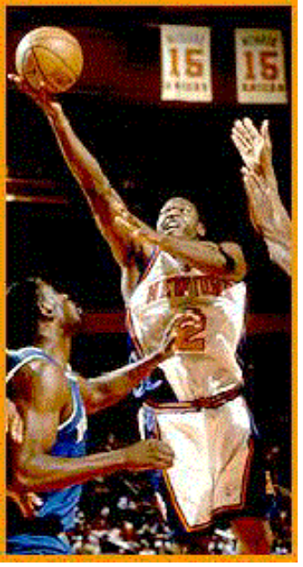
Real Example from NBA
AS (Advanced Scout) software from IBM Research
  Coach can assess the effectiveness of certain coaching decisions
    Good/bad player matchups
    Plays that work well against a given team
Raw Data: Play-by-play information recorded by teams
  Who is on court
  Who took a shot, the type of shot, the outcome, any rebounds

Slide 15
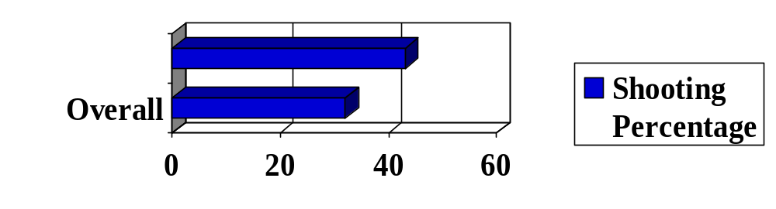
AS Knowledge Discovery
Text Description
  When Price was Point-Guard, J. Williams made 100% of his jump field-goal-attempts. The total number of such attempts is 4.
Graph Description
Starks+Houston+
Ward playing
Reference:
Bhabdari et al. Advanced Scout: Data Mining and Knowledge Discovery in NBA
Data. Data Mining and Knowledge Discovery, 1, 121-125(1997)

Slide 16
Outline
Course Logistics
Data Mining Introduction
Four Key Characteristics
  Combination of Theory and Application
  Engineering Process
  Collection of Functionalities
  Interdisciplinary field
How do we categorize data mining systems?
History of Data Mining
Research Issues
  Curse of Dimensionality

Slide 17
Potential Applications
Data analysis and decision support
  Market analysis and management
    Target marketing, customer relationship management (CRM), market basket analysis, cross selling, market segmentation
  Risk analysis and management
    Forecasting, customer retention, improved underwriting, quality control, competitive analysis
  Fraud detection and detection of unusual patterns (outliers)
Other Applications
  Text mining (news group, email, documents) and Web mining
  Stream data mining
  System and Network Management
  Multimedia Applications
    Music, Image, Video
  DNA and bio-data analysis

Slide 18
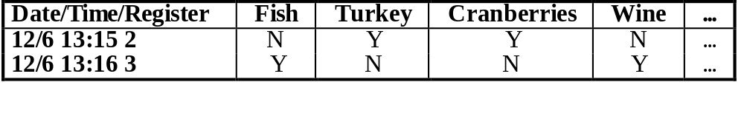
Example: Use in retailing
Goal: Improved business efficiency
  Improve marketing (advertise to the most likely buyers)
  Inventory reduction (stock only needed quantities)
Information source: Historical business data
  Example: Supermarket sales records
  Size ranges from 50k records (research studies) to terabytes (years of data from chains)
  Data is already being warehoused
Sample question – what products are generally purchased together?
The answers are in the data, if only we could see them

Slide 19
Other Applications
Network System management
  Event Mining Research at IBM
Astronomy
  JPL and the Palomar Observatory discovered 22 quasars with the help of data mining
Internet Web Surf-Aid
  IBM Surf-Aid applies data mining algorithms to Web access logs for market-related pages to discover customer preference and behavior pages, analyzing effectiveness of Web marketing, improving Web site organization, etc.

Slide 20
Market Analysis and Management (1)
Where are the data sources for analysis?
  Credit card transactions, loyalty cards, discount coupons, customer complaint calls, plus (public) lifestyle studies
Target marketing
  Find clusters of “model” customers who share the same characteristics: interest, income level, spending habits, etc.
Determine customer purchasing patterns over time
  Conversion of single to a joint bank account: marriage, etc.
Cross-market analysis
  Associations/co-relations between product sales
  Prediction based on the association information

Slide 21
Market Analysis and Management (2)
Customer profiling
  data mining can tell you what types of customers buy what products (clustering or classification)
Identifying customer requirements
  identifying the best products for different customers
  use prediction to find what factors will attract new customers
Provides summary information
  various multidimensional summary reports
  statistical summary information (data central tendency and variation)

Slide 22
Corporate Analysis and Risk Management
Finance planning and asset evaluation
  cash flow analysis and prediction
  contingent claim analysis to evaluate assets
  cross-sectional and time series analysis (financial-ratio, trend analysis, etc.)
Resource planning:
  summarize and compare the resources and spending
Competition:
  monitor competitors and market directions
  group customers into classes and a class-based pricing procedure
  set pricing strategy in a highly competitive market

Slide 23
Fraud Detection and Management (1)
Applications
  widely used in health care, retail, credit card services, telecommunications (phone card fraud), etc.
Approach
  use historical data to build models of fraudulent behavior and use data mining to help identify similar instances
Examples
  auto insurance: detect a group of people who stage accidents to collect on insurance
  money laundering: detect suspicious money transactions (US Treasury's Financial Crimes Enforcement Network)
  medical insurance: detect professional patients and ring of doctors and ring of references

Slide 24
Fraud Detection and Management (2)
Detecting inappropriate medical treatment
  Australian Health Insurance Commission identifies that in many cases blanket screening tests were requested (save Australian $1m/yr).
Detecting telephone fraud
  Telephone call model: destination of the call, duration, time of day or week. Analyze patterns that deviate from an expected norm.
  British Telecom identified discrete groups of callers with frequent intra-group calls, especially mobile phones, and broke a multimillion dollar fraud.
Retail
  Analysts estimate that 38% of retail shrink is due to dishonest employees.

Slide 25
Outline
Course Logistics
Data Mining Introduction
Four Key Characteristics
  Combination of Theory and Application
  Engineering Process
  Collection of Functionalities
  Interdisciplinary field
How do we categorize data mining systems?
History of Data Mining
Research Issues
  Curse of Dimensionality

Slide 26

Data Mining: An Engineering Process
  Data mining: interactive and iterative process.
Interpretation/
Evaluation
Mining Algorithms
Knowledge
Preprocessing
Patterns
Selection
Preprocessed
Data
Data
Target
Data
adapted from:
U. Fayyad, et al. (1995), “From Knowledge Discovery to Data Mining: An Overview,” Advances in Knowledge Discovery and Data Mining, U. Fayyad et al. (Eds.), AAAI/MIT Press
Notes:
Mine for:
Selection
Aggregation
Abstraction
Visualization
Transformation/Conversion
Statistical Analysis
“Cleaning”

Slide 27
Steps of a KDD Process
Learning the application domain
  relevant prior knowledge and goals of application
Creating a target data set: data selection
Data cleaning and preprocessing: (may take 60% of effort!)
Data reduction and transformation
  Find useful features, dimensionality/variable reduction, invariant representation.
Choosing functions of data mining
  summarization, classification, regression, association, clustering.
Choosing the mining algorithm(s)
Data mining: search for patterns of interest
Pattern evaluation and knowledge presentation
  visualization, transformation, removing redundant patterns, etc.
Use of discovered knowledge

Slide 28
Outline
Course Logistics
Data Mining Introduction
Four Key Characteristics
  Combination of Theory and Application
  Engineering Process
  Collection of Functionalities
  Interdisciplinary field
How do we categorize data mining systems?
History of Data Mining
Research Issues
  Curse of Dimensionality

Slide 29
Architecture of a Typical Data Mining System
Graphical user interface
Pattern evaluation
Data mining engine
Knowledge-base
Database or data warehouse server
Data cleaning & data integration
Filtering
Data
Warehouse
Databases

Slide 30
Data Mining: On What Kind of Data?
Relational databases
Data warehouses
Transactional databases
Advanced DB and information repositories
  Object-oriented and object-relational databases
  Spatial databases
  Time-series data and temporal data
  Text databases and multimedia databases
  Heterogeneous and legacy databases
  WWW

Slide 31
What Can Data Mining Do?
Cluster
Classify
  Categorical, Regression
Semi-supervised
Summarize
  Summary statistics, Summary rules
Link Analysis / Model Dependencies
  Association rules
Sequence analysis
  Time-series analysis, Sequential associations
Detect Deviations

